Slide 1
Tactical Level Game AI with Natural Language Input
Student: Piers Williams
Supervisor: Dr Massimo Poesio

Slide 2
Entities
The project uses an Aspect Orientated inspired architecture.
This allows me to create new types of entity without needing to change the Entity class, or sub-class it.

Slide 3
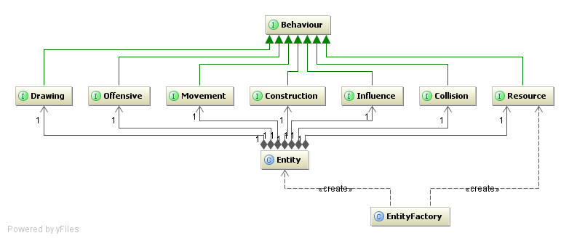
Diagram

